Slide 1
Arrays

Slide 2

ARRAYS
. An array is a collection of elements of the same type that are
referenced by a common name.
. Compared to the basic data type (int, float) it is an
aggregate or derived data type.
. All the elements of an array occupy a set of contiguous
memory locations.
. Why need to use array type?
. Consider the following issue:
○ "We have a list of 1000 students' marks of an
integer type. If using the basic data type
(int), we will declare something like the
following…"
○ int studMark0, studMark1, ...studMark999

Slide 3
. Can you imagine how long we have to
write the declaration part by using
normal variable declaration?
int main(void)
{
int studMark1, studMark2, studMark3,
studMark4, …, …, studMark998, stuMark999,
studMark1000;
…
…
return 0;
}

Slide 4
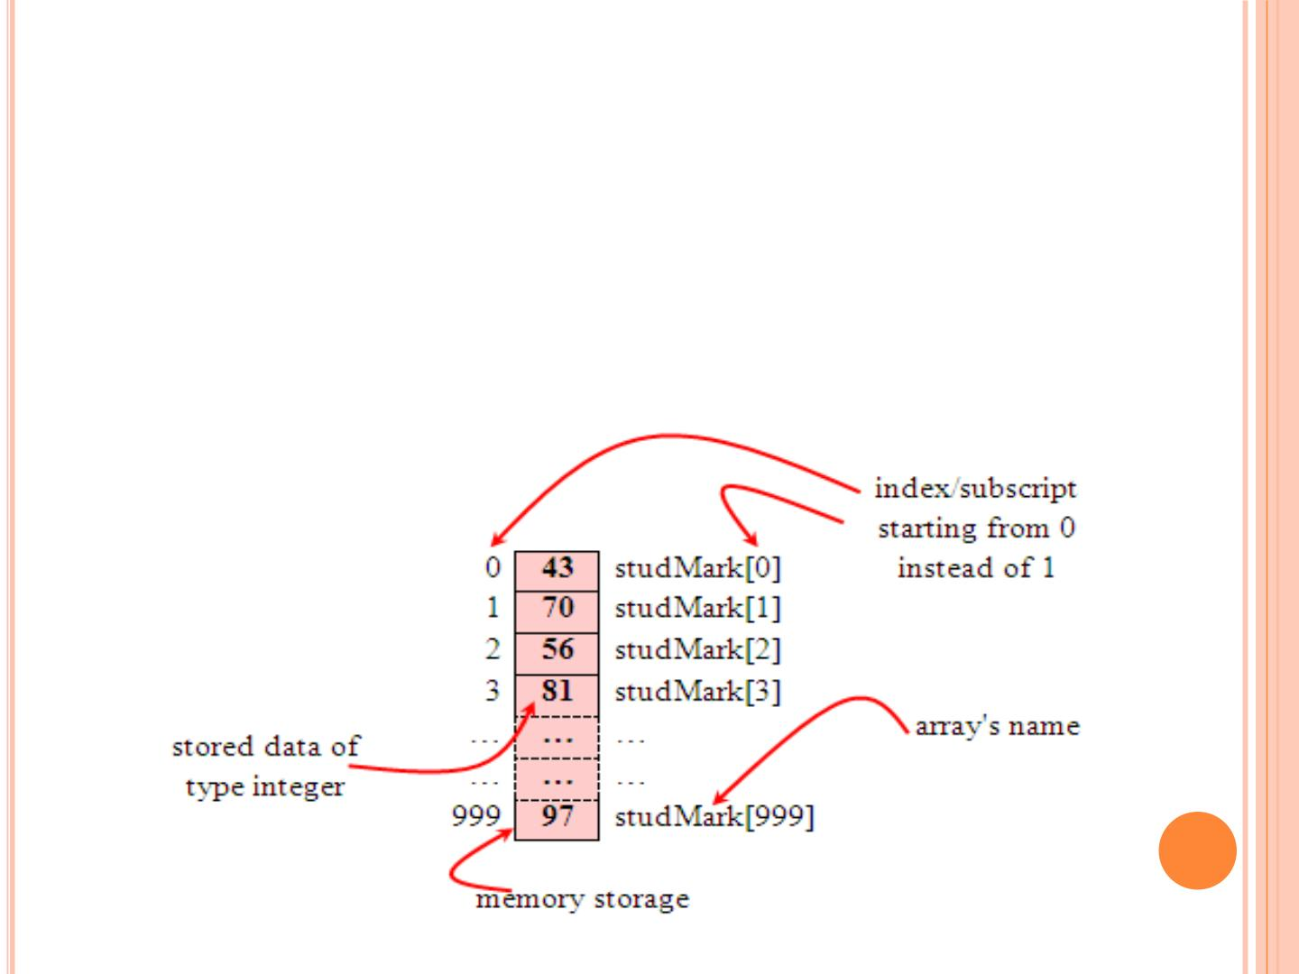
. By using an array, we just declare like this,
○ int studMark[1000];
. This will reserve 1000 contiguous memory locations for
storing the students’ marks.
. Graphically, this can be depicted as in the following
figure.

Slide 5
. This absolutely has simplified our declaration of the
variables.
. We can use index or subscript to identify each
element or location in the memory.
. Hence, if we have an index of j, studMark[j]
would refer to the jth element in the array of
studMark.
. For example, studMark[0]will refer to the first
element of the array.
. Thus by changing the value of j, we could refer to
any element in the array.
. So, array has simplified our declaration and of
course, manipulation of the data.

Slide 6
. A single or one dimensional array declaration
has the following form,
 array_element_data_type array_name[array_
size];
. Here, array_element_data_type defines the base
type of the array, which is the type of each
element in the array.
. array_name is any valid C identifier name that
obeys the same rule for the identifier naming.
. array_size defines how many elements the array
will hold.

Slide 7
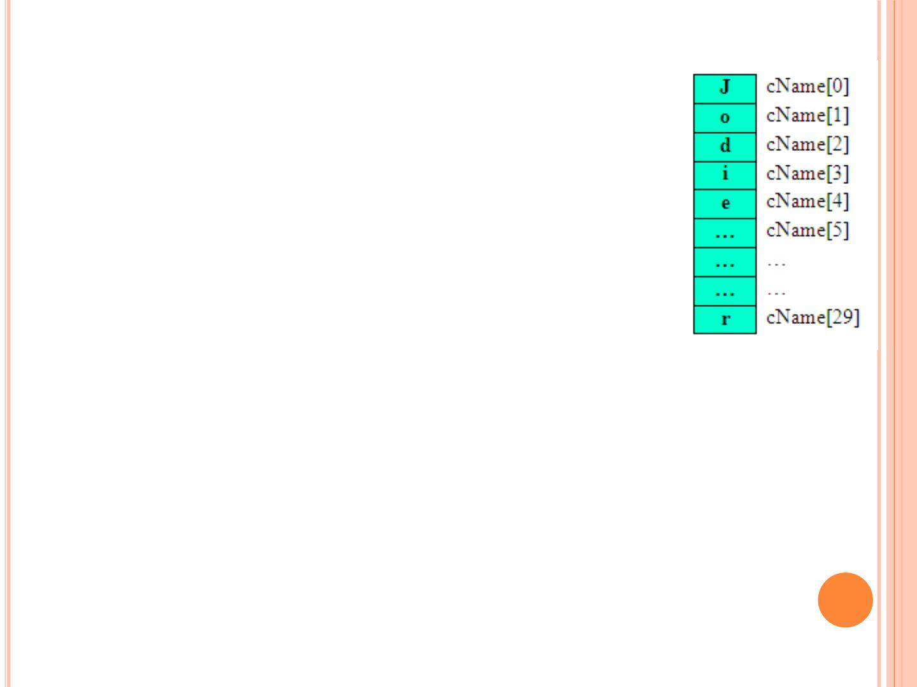
. For example, to declare an array of 30
characters, that construct a people
name, we could declare,
 char cName[30];
. Which can be depicted as follows,
. In this statement, the array character
can store up to 30 characters with the
first character occupying location
cName[0]and the last character
occupying cName[29].
. Note that the index runs from 0to
29. In C, an index always starts from 0
and ends with array's (size-1).
. So, take note the difference between the
array size and subscript/index terms.

Slide 8
. Examples of the one-dimensional array declarations,
○ int xNum[20], yNum[50];
○ float fPrice[10], fYield;
○ char chLetter[70];
. The first example declares two arrays named xNumand yNum
of type int. Array xNumcan store up to 20 integer numbers
while yNumcan store up to 50 numbers.
. The second line declares the array fPriceof type float. It
can store up to 10 floating-point values.
. fYieldis basic variable which shows array type can be
declared together with basic type provided the type is
similar.
. The third line declares the array chLetterof type char. It
can store a string up to 69 characters.
. Why 69 instead of 70? Remember, a string has a null
terminating character (\0) at the end, so we must reserve for
it.

Slide 9
ARRAY INITIALIZATION
.
An array may be initialized at the time of declaration.
.
.
Initialization of an array may take the following form,
○ type array_name[size] = {a_list_of_value};
For example:
○ int idNum[7] = {1, 2, 3, 4, 5, 6, 7};
○ float fFloatNum[5] = {5.6, 5.7, 5.8, 5.9, 6.1};
○ char chVowel[6] = {'a', 'e', 'i', 'o', 'u',
'\0'};
.
.
The first line declares an integer array idNumand it immediately
assigns the values 1, 2, 3, ..., 7 to idNum[0], idNum[1],
idNum[2],..., idNum[6]respectively.
The second line assigns the values 5.6 to
fFloatNum[0], 5.7 to fFloatNum[1], and so on.
.
.
Similarly the third line assigns the characters 'a' to chVowel[0],
'e' to chVowel[1], and so on. Note again, for characters we must
use the single apostrophe/quote (') to enclose them.
Also, the last character in chVowelis NULLcharacter ('\0').

Slide 10
. Initialization of an array of type char for holding strings
may take the following form,
 char array_name[size] =
"string_lateral_constant";
. For example, the array chVowelin the previous example
could have been written more compactly as follows,
 char chVowel[6] = "aeiou";
. When the value assigned to a character array is a string
(which must be enclosed in double quotes), the compiler
automatically supplies the NULLcharacter but we still
have to reserve one extra place for the NULL.
. For unsized array (variable sized), we can declare as
follow,
 char chName[ ] = "Mr. Dracula";
. C compiler automatically creates an array which is big
enough to hold all the initializer.

Slide 11
RETRIEVING ARRAY ELEMENTS
○ If you want to retrieve specific element then then
you have to specify not only the array or variable
name but also the index number of interest.
○ For example:
○ int Arr[]={1,3,5,6,8};
○ printf(“%d\t%d\n”,Arr[1],Arr[2]);
○ Output: 3 5

Slide 12
ARRAY EXAMPLE
○ Take 10 integer input from user and store then in an
array and find the sum of all numbers stored in array.
#include<stdio.h>
int main(){
int i,sum=0,arr[10];
for(i=0;i<10;i++)
scanf(“%d”,&arr[i]);
for(i=0;i<10;i++)
sum+=arr[i];
printf(“Sum of input integers is %d\n”,sum);
return 0;
}

Slide 13
Summarize the response of a survey.
Input: Response of the survey, can be in the range
between 0 and 10. Assume the population size to
be 40.
Output: Frequency of each response.

Slide 14
○ #include<stdio.h>
○ #define SIZE 40
○ #define ANS 11
○ int main(void) {
○
○
○
○
○
○
○
int response[SIZE];
int freq[ANS] = {0};
int i;
for(i=0; i< SIZE; i++){
scanf(“%d”,&response[i]);
++freq[response[i]];
}
○
for(i=0;i<ANS;i++)
○
printf("Frequency of %d is %d\n",i,freq[i]);
○ }

Slide 15
ASSIGNMENT
○ Read from user ages of all students in class and
save them in an array which can store floating
point and find average, minimum and maximum
age.
○ A six faced die is rolled 600 times. Find the
frequency of the occurrence of each face?

Slide 16
○ int rand(void): returns a pseudo-random
number in the range of 0 to RAND_MAX.
○ RAND_MAX: is a constant whose default value
may vary between implementations but it is
granted to be at least 32767.
○ Issue: If we generate a sequence of random
number with rand() function, it will create the
same sequence again and again every time
program runs.

Slide 17
○ The srand() function sets the starting point for
producing a series of pseudo-random integers. If
srand() is not called, the rand() seed is set as if
srand(1) were called at program start.
○ The pseudo-random number generator should
only be seeded once, before any calls to rand(),
and the start of the program.
○ Standard practice is to use the result of a call
to srand(time(0)) as the seed. However, time()
returns a time_t value which vary everytime and
hence the pseudo-random number vary for every
program call.

Slide 18
#include<stdio.h>
int main(){
int i,j,arr[7]={0};
srand(time(0));
for (i=0;i<600;i++){
j=rand()%6;
j=j+1;
arr[j]++;
}
for(i=1;i<=6;i++)
printf("%d came out for %d times\n",i,arr[i]);
return 0;
}

Slide 19
○ [sourav@gaya]$ ./a.out
1 came out for 113 times
2 came out for 114 times
3 came out for 102 times
4 came out for 86 times
5 came out for 99 times
6 came out for 86 times

Slide 20
ASSIGNMENT
○ Store marks obtained by students in an array.
Find if there is more than one student who scored
same marks. Assume minimum marks obtained
is 30 and maximum marks obtained is 85.

Slide 21
#include<stdio.h>
int main(){
int i,j,x,arr[10];
printf("Enter 10 integer number\n");
for(i=0;i<10;i++){
scanf("%d",&arr[i]);
}
for(i=0;i<9;i++){
x=arr[i];
for(j=i+1;j<10;j++){
if(x==arr[j])
printf("%d number appeared more than once\n",x);
}
}
return 0;
}

Slide 22
○ [sourav@gaya]$ ./a.out
Enter 10 integer number
1
2
3
4
5
6
2
4
8
9
2 number appeared more than once
4 number appeared more than once

Slide 23
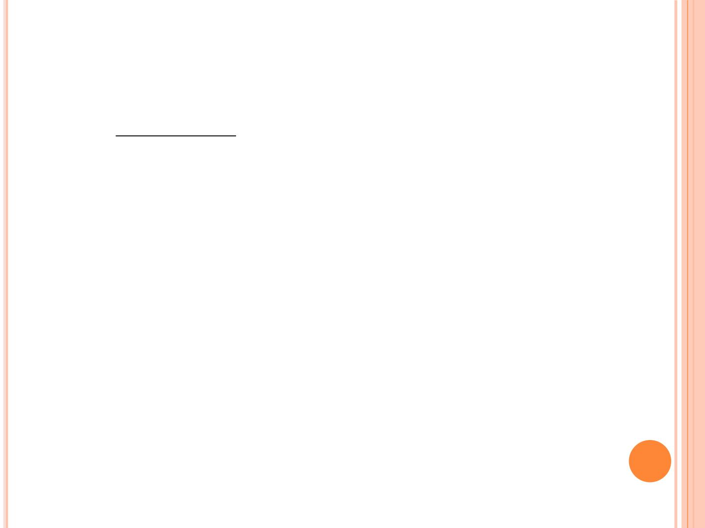
TWO DIMENSIONAL/2D ARRAYS
. A two dimensional array has two subscripts/indexes.
. The first subscript refers to the row, and the second, to the
column.
. Its declaration has the following form,
_{ data_type array_name[1}^{st} dimension size][2nd dimension
size];
. For examples,
 int xInteger[3][4];
 float matrixNum[20][25];
. The first line declares xIntegeras an integer array with 3
rows and 4 columns.
. Second line declares a matrixNumas a floating-point array
with 20 rows and 25 columns.

Slide 24
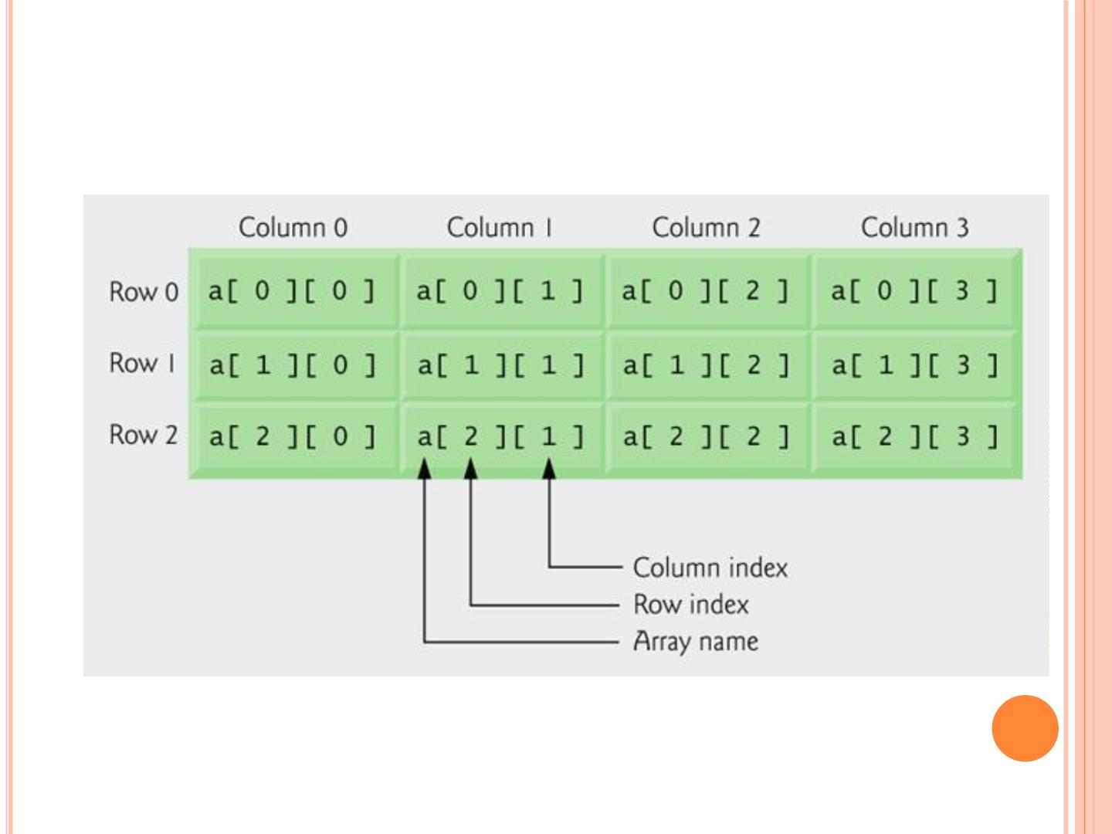
DOUBLE SCRIPTED ARRAY WITH 3 ROWS AND 4
COLUMNS

Slide 25
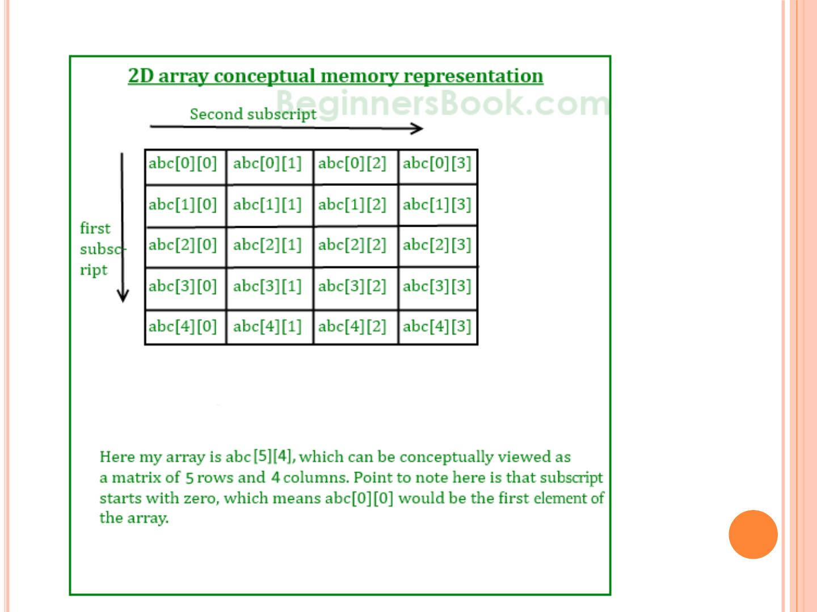

Slide 26
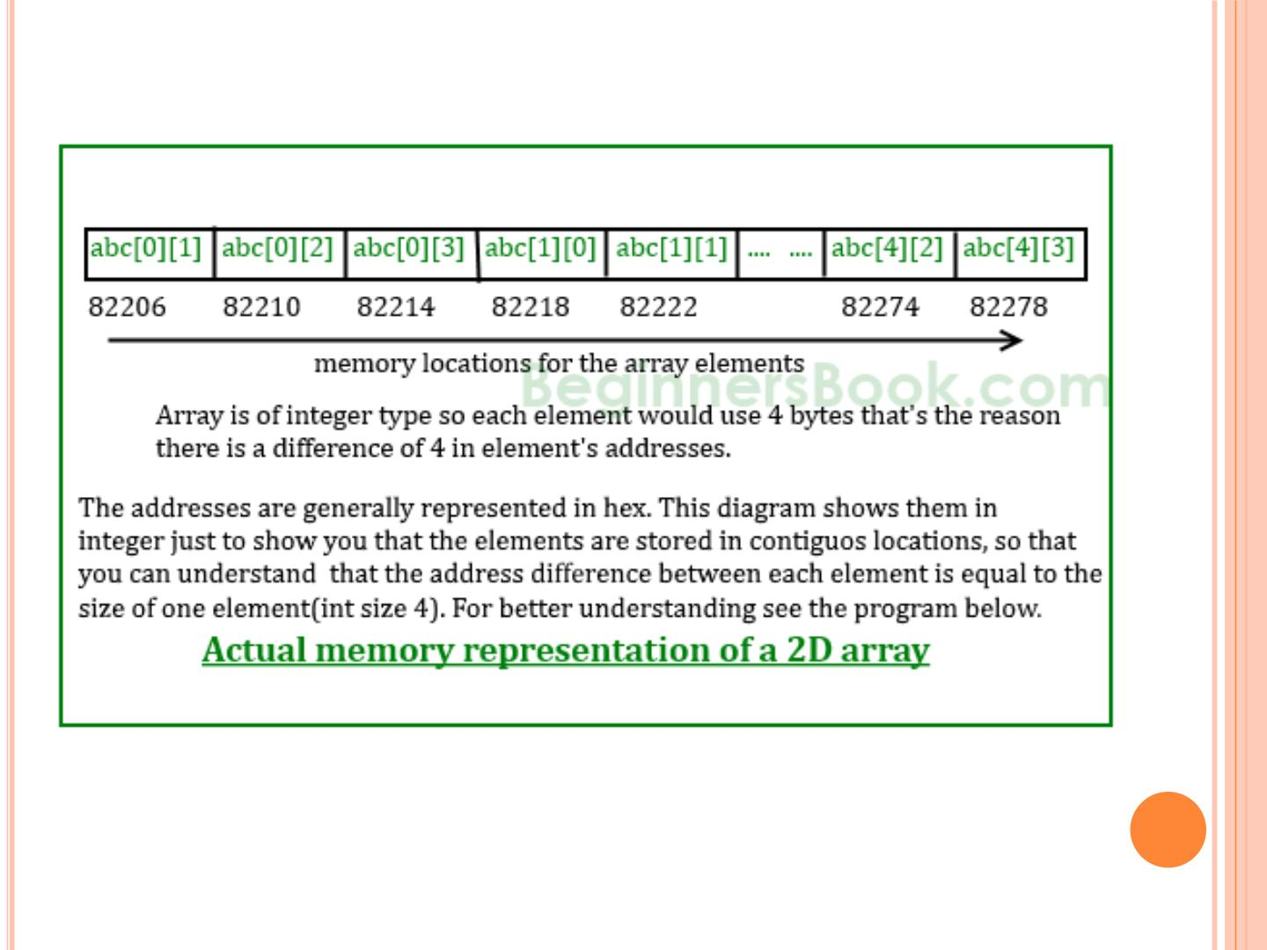

Slide 27
○ #include <stdio.h>
○ int main() {
 int abc[5][4] ={ {0,1,2,3}, {4,5,6,7}, {8,9,10,11},
{12,13,14,15}, {16,17,18,19} };
 for (int i=0; i<=4; i++) {
○ printf("%d ",abc[i]);
 }
 return 0;
○ }
○ Output: 1600101376 1600101392 1600101408
1600101424 1600101440

Slide 28
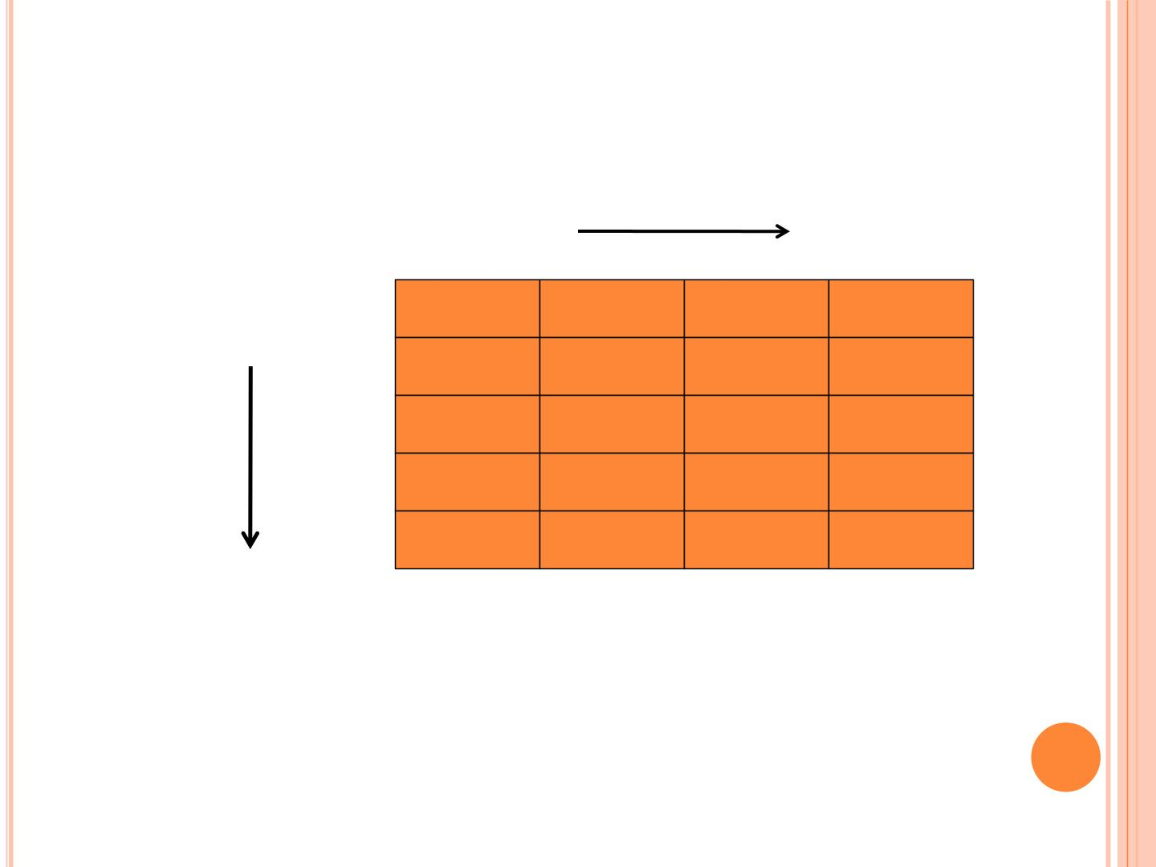
LIST OF STUDENTS AND THEIR SUBJECT
MARKS
Ma rks
S tude nts
10 23 31 11
20 43 21 21
12 22 30 13
30 31 26 41
13 03 41 15
Find the average mark scored by each
s tude nt?

Slide 29
#include<stdio.h>
#define ROW 5
#define COL 4
int main(void)
{
int i, j;
double total;
int marks[ROW][COL]= { 10, 23, 31, 11, 20, 43, 21, 21,12,
22, 30, 13, 30, 31, 26, 41,13, 03, 41, 15 };
for(i = 0; i < ROW ; i++)
{
total = 0.0;
for (j=0; j<COL; j++)
total+=marks[i][j];
printf("Average of student %d is %f\n", i, total/4.0);
}
}

Slide 30
INITIALIZATION OF 2D ARRAY
○ int disp[2][4] = { {10, 11, 12, 13}, {14, 15, 16, 17} };
○ OR
○ int disp[2][4] = { 10, 11, 12, 13, 14, 15, 16, 17};
_{ 1}st one is recommended.

Slide 31
THINGS THAT YOU MUST CONSIDER WHILE
INITIALIZING A 2D ARRAY
○ We already know, when we initialize a normal array (or
you can say one dimensional array) during declaration, we
need not to specify the size of it. However that’s not the
case with 2D array, you must always specify the second
dimension even if you are specifying elements during the
declaration.
○ /* Valid declaration*/
○ int abc[2][2] = {1, 2, 3 ,4 }
○ /* Valid declaration*/
○ int abc[][2] = {1, 2, 3 ,4 }
○ /* Invalid declaration – you must specify second
dimension*/
○ int abc[][] = {1, 2, 3 ,4 }
○ /* Invalid because of the same reason mentioned above*/
○ int abc[2][] = {1, 2, 3 ,4 }

Slide 32
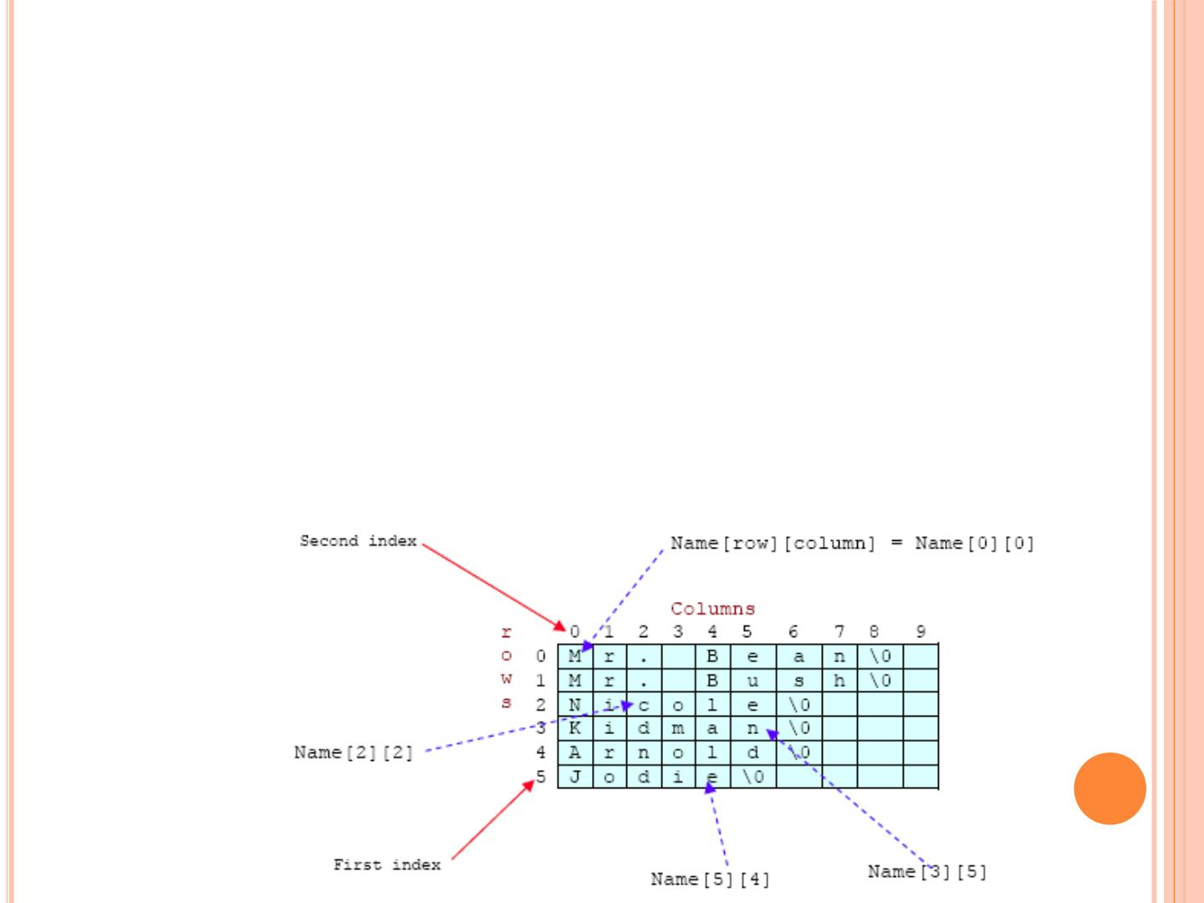
. For array storing string
 char Name[6][10] = {"Mr. Bean", "Mr. Bush",
"Nicole", "Kidman", "Arnold", "Jodie"};
. Here, we can initialize the array with 6 strings, each with
maximum 9 characters long.
. If depicted in rows and columns it will look something
like the following and can be considered as contiguous
arrangement in the memory.

Slide 33
ASSIGNMENTS
○ Print Transpose of a Matrix
○ Add Two Matrix Using Multi-dimensional Arrays
○ Multiply to Matrix Using Multi-dimensional
Arrays

Slide 34
#include <stdio.h>
void main()
{
static int array[10][10];
int i, j, m, n;
printf("Enter the order of the matrix \n");
scanf("%d %d", &m, &n);
printf("Enter the coefiicients of the matrix\n");
for (i = 0; i < m; ++i){
for (j = 0; j < n; ++j){
scanf("%d", &array[i][j]);
}
}

Slide 35
printf("The given matrix is \n");
for (i = 0; i < m; ++i){
for (j = 0; j < n; ++j){
printf(" %d", array[i][j]);
}
printf("\n");
}
printf("Transpose of matrix is \n");
for (j = 0; j < n; ++j){
for (i = 0; i < m; ++i){
printf(" %d", array[i][j]);
}
printf("\n");
}
}

Slide 36
#include <stdio.h>
int main()
{
int r, c, a[100][100], b[100][100], sum[100][100], i, j;
printf("Enter number of rows (between 1 and 100): ");
scanf("%d", &r);
printf("Enter number of columns (between 1 and 100): ");
scanf("%d", &c);
printf("\nEnter elements of 1st matrix:\n");
for(i=0; i<r; ++i) {
for(j=0; j<c; ++j) {
printf("Enter element a%d%d: ",i+1,j+1);
scanf("%d",&a[i][j]);
}
}

Slide 37
printf("Enter elements of 2nd matrix:\n");
for(i=0; i<r; ++i)
for(j=0; j<c; ++j) {
printf("Enter element a%d%d: ",i+1, j+1);
scanf("%d", &b[i][j]);
}
// Adding Two matrices
for(i=0;i<r;++i)
for(j=0;j<c;++j) {
sum[i][j]=a[i][j]+b[i][j];
}
// Displaying the result
printf("\nSum of two matrix is: \n\n");
for(i=0;i<r;++i)
for(j=0;j<c;++j) {
printf("%d ",sum[i][j]);
if(j==c-1) { printf("\n\n"); }
}
return 0;
}

Slide 38
○ #include <stdio.h>
○ int main() {
 int a[10][10], b[10][10], result[10][10], r1, c1, r2, c2, i,
j, k;
 printf("Enter rows and column for first matrix: ");
 scanf("%d %d", &r1, &c1);
 printf("Enter rows and column for second matrix: ");
 scanf("%d %d",&r2, &c2);
 while (c1 != r2) {
○ printf("Error! Not compatible for multiplication\n");
 }

Slide 39
 printf("\nEnter elements of matrix 1:\n");
 for(i=0; i<r1; ++i)
○ for(j=0; j<c1; ++j) {
○ printf("Enter elements a%d%d: ",i+1, j+1);
○ scanf("%d", &a[i][j]);
○ }
 printf("\nEnter elements of matrix 2:\n");
 for(i=0; i<r2; ++i)
○ for(j=0; j<c2; ++j) {
○ printf("Enter elements b%d%d: ",i+1, j+1);
scanf("%d",&b[i][j]);
○ }

Slide 40
 // Initializing all elements of result matrix to 0
 for(i=0; i<r1; ++i)
○ for(j=0; j<c2; ++j) {
○ result[i][j] = 0;
○ }
 // Multiplying matrices a and b and // storing result in result matrix
for(i=0; i<r1; ++i)
○ for(j=0; j<c2; ++j)
○ for(k=0; k<c1; ++k) {
 result[i][j]+=a[i][k]*b[k][j];
○ }

Slide 41
 // Displaying the result
 printf("\nOutput Matrix:\n");
 for(i=0; i<r1; ++i)
○ for(j=0; j<c2; ++j) {
○ printf("%d ", result[i][j]);
○ if(j == c2-1) printf("\n\n");
○ }
 return 0;
○ }

Slide 42
3D: A 3D ARRAY IS AN ARRAY OF 2D
ARRAYS.
○ #include<stdio.h>
○ int main(){
○ int
i,j,k,x[][2][3]={{{1,2,3},{4,5,6}},{{7,8,9},{10,11,12}}};
○ for(i=0;i<2;i++)
○
○
○
for(j=0;j<2;j++)
for(k=0;k<3;k++){
printf("x[%d,%d,%d]=%d\n",i,j,k,x[i][j][k]);
}
○
○ return 0;
○ }

